Slide 1

Buy a Feature: an Adventure in Immutability and Actors
  David Pollak
  BayFP August 22, 2008

Slide 2
David Pollak
Not strict, but pretty lazy
Lead developer for Lift web framework
Scala since November 2006, Ruby/Rails, Java/J2EE
Spreadsheet junky (writing more than using)‏
Paying work (all Lift based):
  Enthiosys' Buy a Feature
  SAP's ESME project
  Gump-it: stuff worth missing

Slide 3
About Buy a Feature (online)‏
The first of Enthiosys' online Innovation Games
Serious Gaming for Agile Product Management
Game Play:
  Create a list of product features with estimated costs
  4-8 player buy features that they want
  Motivate negotiations between players
  Learn how players sell each other on features

Slide 4
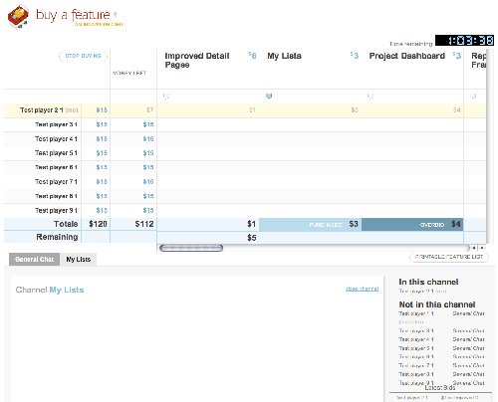
Buy a Feature

Slide 5
About Scala & Lift
Scala
  Hybrid OO & Functional Language
  Compiles to Java Byte-Code and runs fast on JVM
  Compatible with Java libraries
  FP concepts including Actors and Immutablity
Lift
  Concise, powerful web framework
  Leverages Scala's functional features
  Awesome Comet and AJAX support

Slide 6
Buy a Feature Architecture
Lift based Comet front-end
UI state managed in Lift CometActors
All user interaction via JSON messages/events
Events sent to GameActor
GameActor updates GameBoard and writes events
GameActor sends GameBoard, etc. to CometActors

Slide 7
Actors – Why?
Excellent concurrency management
Event oriented
Asynchronous
case EndGame =>
recordGameEnding()
this ! ChatMessage(Empty, timeNow,
"Game Ended", Empty, Empty)
eachListener(_ ! EndGame)‏

Slide 8
Actors – Where?
UI
  Pushes UI state changes out to browser
  Listen for incoming events/messages
Cross-session Game managers
  Incoming events serialized
  Incoming events → New State
  New State → Listners (other Actors)‏

Slide 9
Events – Why?
Anything that can change state is an Event
Events are timestamped and written to RDBMS
Events can be replayed through the system for TiVo style game replay and pausing
Complementary to Actors

Slide 10
Events – Where?
Broswer → Server (CometActor)‏
CometActor → GameActor
GameActor → RDBMS
GameActor → Listners (mostly UI CometActor)‏
CometActor → Browser

Slide 11
Post-Processing
Game Events are recalled, in order from RDBMS
Game Events are send through the GameBoard
GameBoard is queried for results
GameBoard is immutable, so a separate copy can be associated with each Event
Thus, there's a freeze-frame at each event

Slide 12
Defects
Lift session bugs
  Lots of stupid problems working around J2EE sessions
  Why? I'm a moron
Parsing
  Users entering free text → lots of unexpected input
  Most of our tests are here
Post-processing
  Didn't use GameBoard, but rolled my own – bad results
  Too many GameBoards in memory

Slide 13
Team Integration
Disbelief over code size
Attempts to dive below the abstractions
Java-like coding on the road to functional
Eventual adoption of map, fold, and filter
NPE: Thing of the past
Lack of tool support and examples in the wild are speed bumps, especially with existing code
Need a team mentor to help with transition

Slide 14
Conclusion
Amazing productivity for people once up the FP curve
Very low defect rate
None of the defects were concurrency related!!
None of the defects were concurrency related!!
Very flexible system (added Flash front end in a day)‏

Slide 15
End
Questions?

Slide 16
Scala: Functions are Objects
Objects can be passed as parameters
Functions are syntactically easy to create
var name = “”
SHtml.text(name, name = _)‏
They bind to variables/values (e.g. name)‏

Slide 17
Partial Functions
PartialFunction[A,B] extends Function1[A,B]
isDefinedAt(x: A)‏
Better known as pattern matching:
{
case Foo(bar) => bar
case Baz(dog) => dog
}

Slide 18
Composing Partial Function
{ case Foo(bar) => bar
case Baz(dog) => dog
} orElse { // compose
case Moo(cow) => cow
case Meow(cat) => cat
}

Slide 19
Extractors and Guards
Extract data while matching other parts in a pattern:
{ case “Foo” :: id :: Nil => doIt(id) }
Guards:
{ case “Foo” :: id :: Nil
if isValid(id) && loggedIn_? =>
doIt(id) }

Slide 20
Remembering Functions
Functions are Objects
Map[String, String => XML]
Map[String, PartialFunction[String, XML]]
GET /ajax?OPAQUE_ID=someValue
Map[OPAQUE_ID](someValue)‏

Slide 21
XML literals and manipulation
In Scala, XML is like String: supported at the language level and immutable
<foo>{(1 to 10).
map(i => <val>{i}</val>)}</foo>
(xml \ “val”).map(_.text.toInt).
.foldLeft(0)(_ + _) == 55

Slide 22
Actors and Partial Functions
Threadless, stackless units of execution
React to events and otherwise consume nothing but memory
react(PartialFunction[Any, Any]) →
react {case Foo(bar) => doSomething(bar)
case Baz(dog) =>
doElse(dog) }
react(primaryHndlr orElse secondaryHndler)‏

Slide 23
Lift REST APIs
LiftRules.addDispatchBefore {
case RequestMatcher(
RequestState(
"showstates":: xs, _),_) =>
XmlServer.showStates(xs) }
def showStates(...) = XmlResponse(
<states renderedAt={timeNow.toString}>
... </states>)‏

Slide 24
Lift and HTML forms
var name = “”
text(name, name = _)‏
def setLocale(loc: String) ...
select(Locale.getAvailableLocales.toList.
map(lo => (lo.toString, lo.getDisplayName)),
setLocale)‏

Slide 25
Lift & AJAX
AJAX elements are bound to functions:
a(() => {cnt = cnt + 1; SetHtml("cnt_id", Text( cnt.toString))}, “click me”)‏
ajaxSelect(opts,
v => DisplayMessage("You selected "+v))‏

Slide 26
Lift CometActors
Lift deals with all the plumbing:
def render = bind("time" -> timeSpan)
override def lowPriority = {
case Tick => reRender(false)
}

